Slide 1

MITRE ENGAGE
EMPOWERING CYBERSECURITY THROUGH ADVESARY ENGAGEMENT
WEEK – 10
- SANDHYA

Slide 2

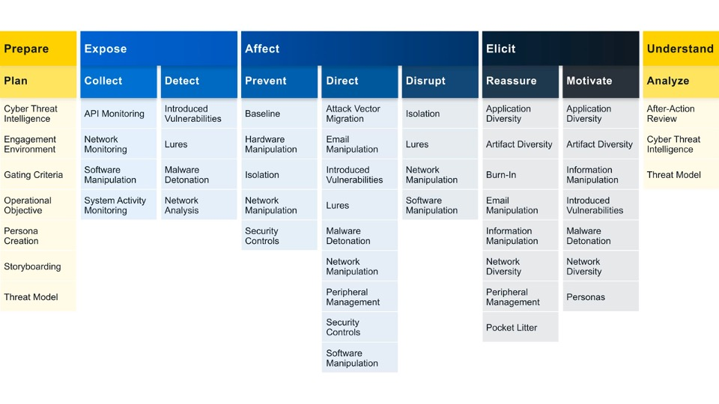
ENGAGE GOAL : EXPOSE
We can Expose adversaries on the network by using deceptive activities to provide high fidelity alerts when adversaries are active in the engagement environment.
Engage Approaches: Helps us to identify what actions we would like to take against our adversary and helps us to drive progress towards that impact.
The two engagement approaches under expose includes: COLLECT AND DETECT
COLLECT: Gather adversary tools, observe tactics, and collect other raw intelligence about the adversary’s activity.
DETECT: Establish or maintain awareness regarding adversary activity. Detection activities focus on the defender’s ability to monitor adversary activity throughout an environment, often by creating high-fidelity detections.

Slide 3
1. System Activity Monitoring Using Sysmon
Sysmon, short for System Monitor, is a powerful system monitoring tool for Linux operating systems that provides comprehensive insights into the system's performance, activities, and resource utilization.
It is designed to track and log various system activities, such as process creations, network connections, file creations, and more, enabling administrators to effectively monitor and analyze system behavior.
Sysmon offers a holistic view of the system's activities, helping users identify potential security threats, track down suspicious activities, and troubleshoot performance issues.
By capturing detailed information about system events, Sysmon plays a crucial role in enhancing the overall security posture and operational efficiency of Linux systems.
With its extensive logging capabilities, Sysmon serves as a valuable resource for detecting and analyzing security incidents and potential breaches. It enables system administrators and security professionals to monitor and audit critical system events in real-time,

Slide 4

2. NETWORK MONITORING USING SNORT
SNORT is a powerful open-source intrusion detection system (IDS) and intrusion prevention system (IPS) that provides real-time network traffic analysis and data packet logging. SNORT uses a rule-based language that combines anomaly, protocol, and signature inspection methods to detect potentially malicious activity.
Using SNORT, network admins can spot denial-of-service (DoS) attacks and distributed DoS (DDoS) attacks, Common Gateway Interface (CGI) attacks, buffer overflows, stealth port scans and various other attacks. SNORT creates a series of rules that define malicious network activity, identify malicious packets, and send alerts to users.
SNORT is a free-to-use open-source piece of software that can be deployed by individuals and organizations. The SNORT rule language decides the network traffic to monitor and the actions to take upon detecting harmful packets. It functions similarly to sniffers and intrusion detection systems, capable of identifying malicious packets.
Snort has three main modes:
packet sniffer -(similar to Wireshark) ­ displays the network traffic in real time
packet logger -(useful e.g. for network traffic debugging) ­ saves the network traffic to the disk
network intrusion detection ­-matches the network traffic against signatures and performs the specified actions

Slide 5
2. NETWORK MONITORING USING SURICATA
Reasons why Suricata is preferred more than Snort:
Multithreading Support:
Suricata is designed with native multithreading support, allowing it to efficiently utilize modern multi-core processors. This enables Suricata to handle a higher volume of network traffic and process multiple tasks concurrently, improving overall performance.
Snort, on the other hand, traditionally relies on a single-threaded architecture, which may limit its scalability on systems with multiple cores.
Logs can be integrated with Wazuh:
Suricata’s logs can be easily integrated with Wazuh and elastic search, hence it helps to monitor and analyze packets efficiently.
Restricted Alert Generation:
Snort was not able to generate many alerts in T-pot, especially for the alerts which I am going to cover in my further slides, so Suricata is efficient for network monitoring compared to Snort.
4. Protocol Detection and Parsing:
Suricata has enhanced protocol support and parsing capabilities, enabling it to detect and analyze a wide range of network protocols effectively. This is crucial for identifying sophisticated attacks that may involve multiple protocols or non-standard communication patterns.
Snort is proficient in protocol detection, but Suricata's extended protocol support provides an edge in certain complex network environments.

Slide 6
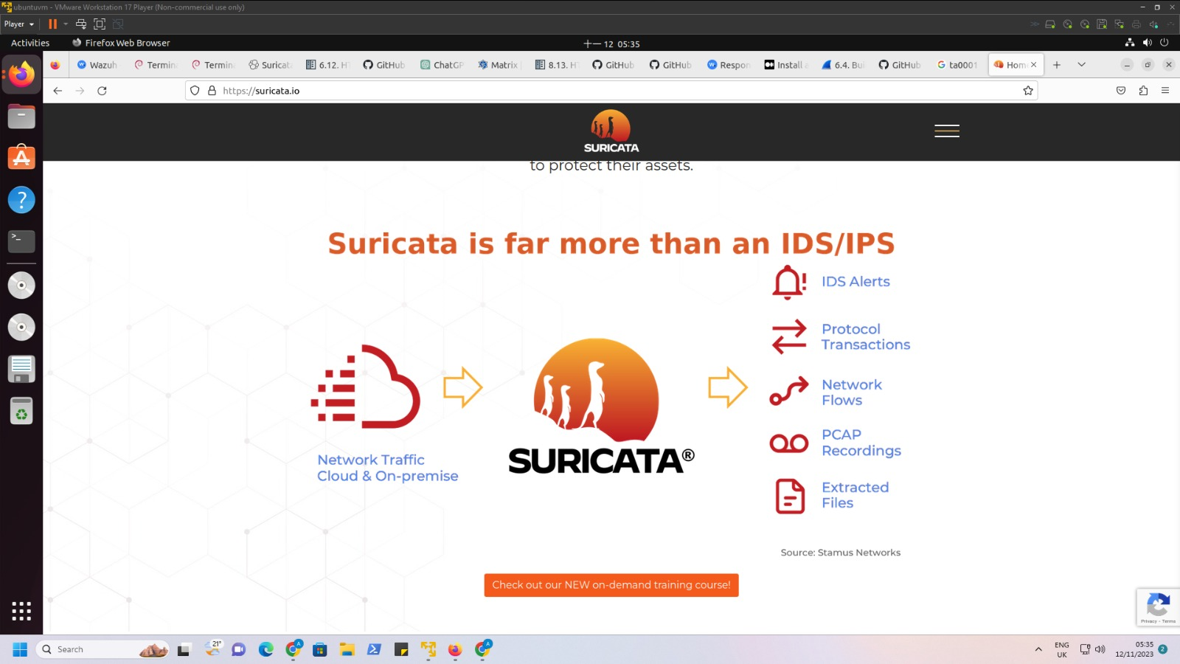
INTRODUCTION TO SURICATA
Suricata is a free and open-source threat detection engine. It does this by combining IDS,IPS, and network security monitoring.
Suricata is owned and developed by the community-run-non-profit organization OSIF(Open Information Security Foundation)
GitHub Repository: https://github.com/OSIF/suricata
Suricata serves as an Intrusion Detection System (IDS) and Intrusion Prevention System (IPS), helping organizations monitor and secure their network infrastructure.
Suricata has 2 main operational modes:
Active(IPS)- Used to alert, log and block network traffic that matches specific rules.
Passive(IDS)- Used to identify, alert and log suspicious network traffic within a network.

Slide 7
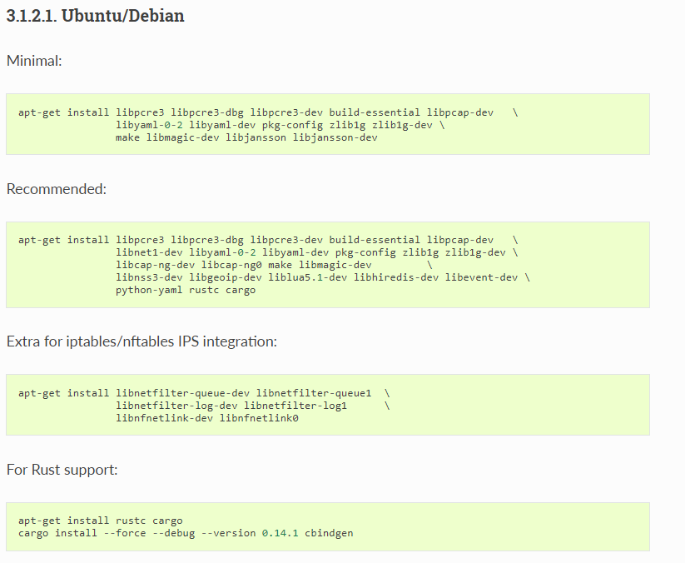
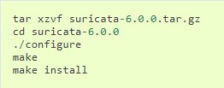
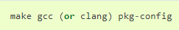
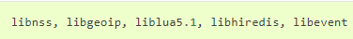
INSTALLING AND CONFIGURING SURICATA
Installing from the source distribution files gives the most control over the Suricata installation.
Basic step-1:
This will install Suricata into /usr/local/bin/, use the default configuration in /usr/local/etc/suricata/ and will output to /usr/local/var/log/suricata.
2. Dependencies:
For Suricata’s compilation we’ll need the following libraries and their development headers installed:
The following tools are required:
Commands to be executed:

Slide 8
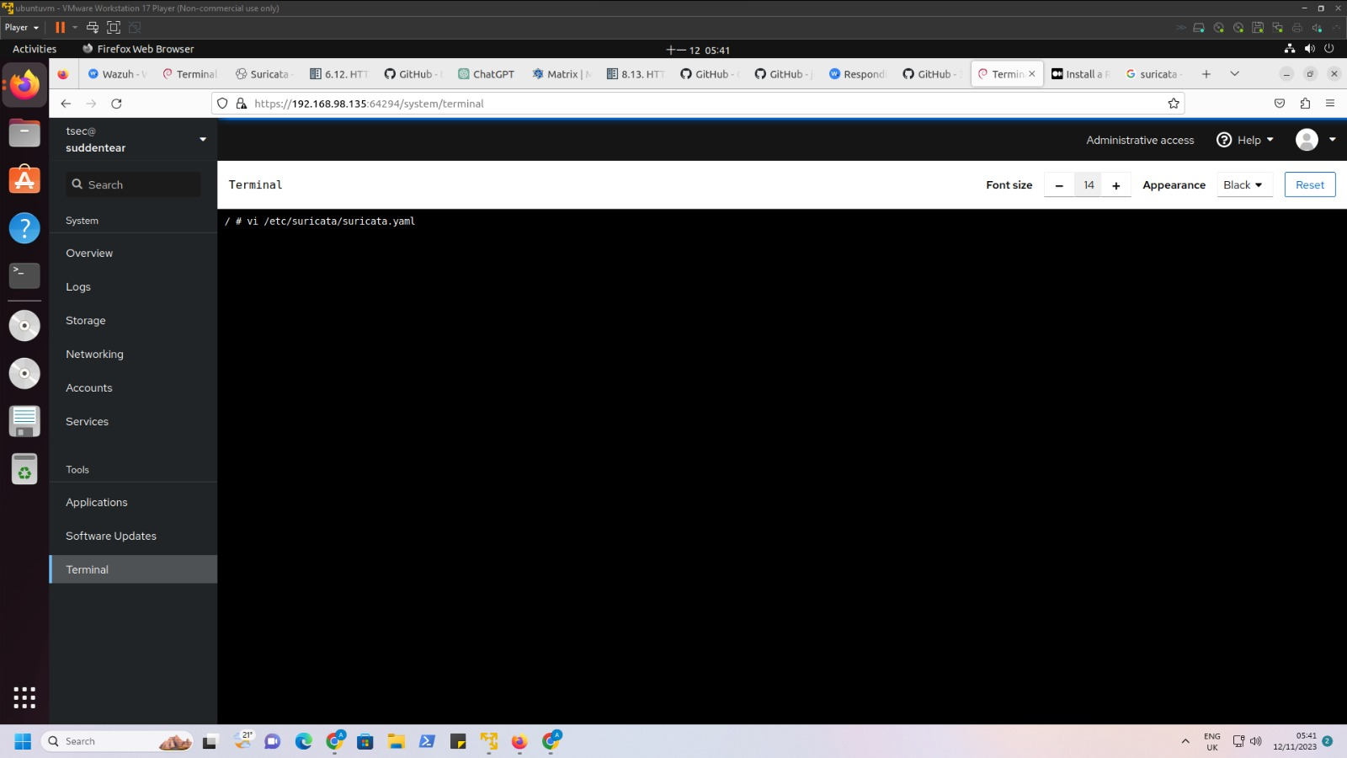
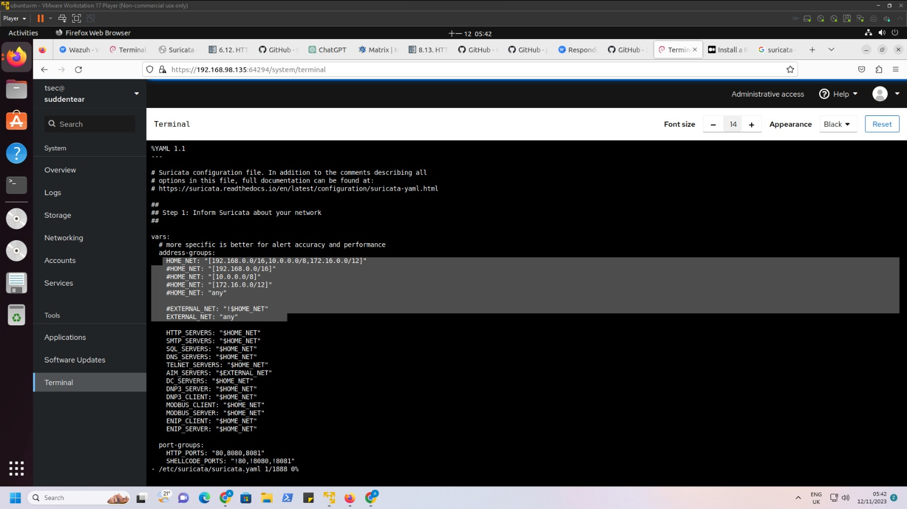
Configuration File

Slide 9
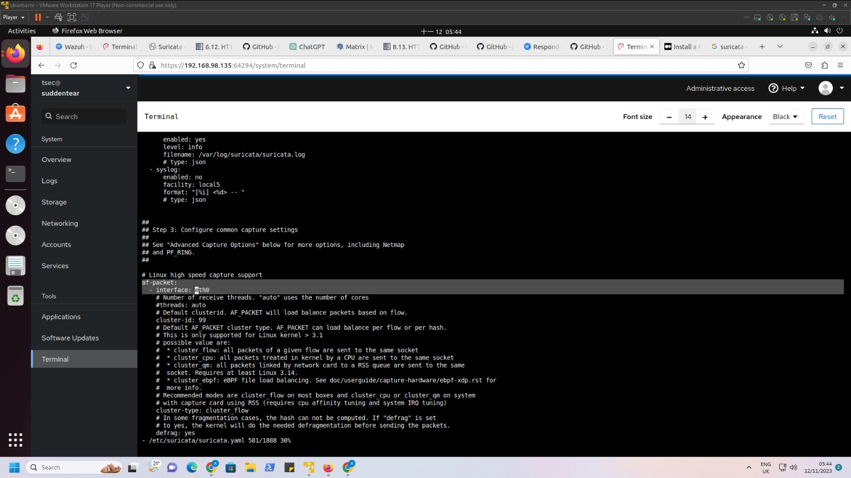

Slide 10
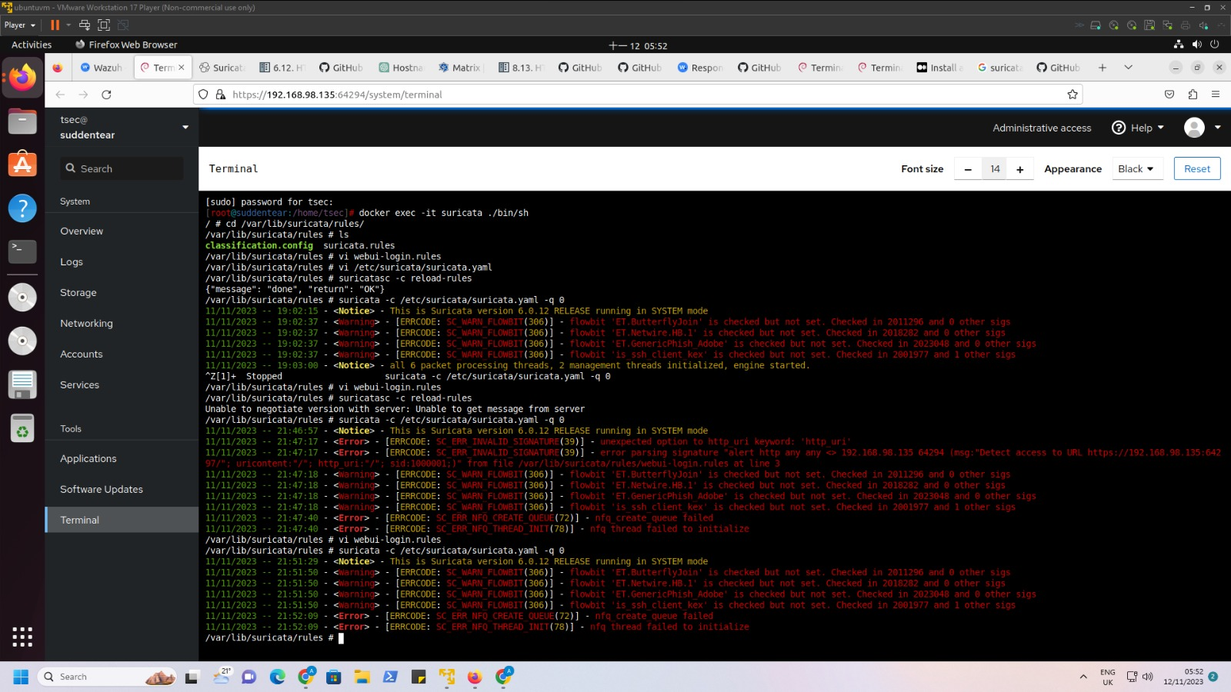
Configuring Suricata Rules file:

Slide 11
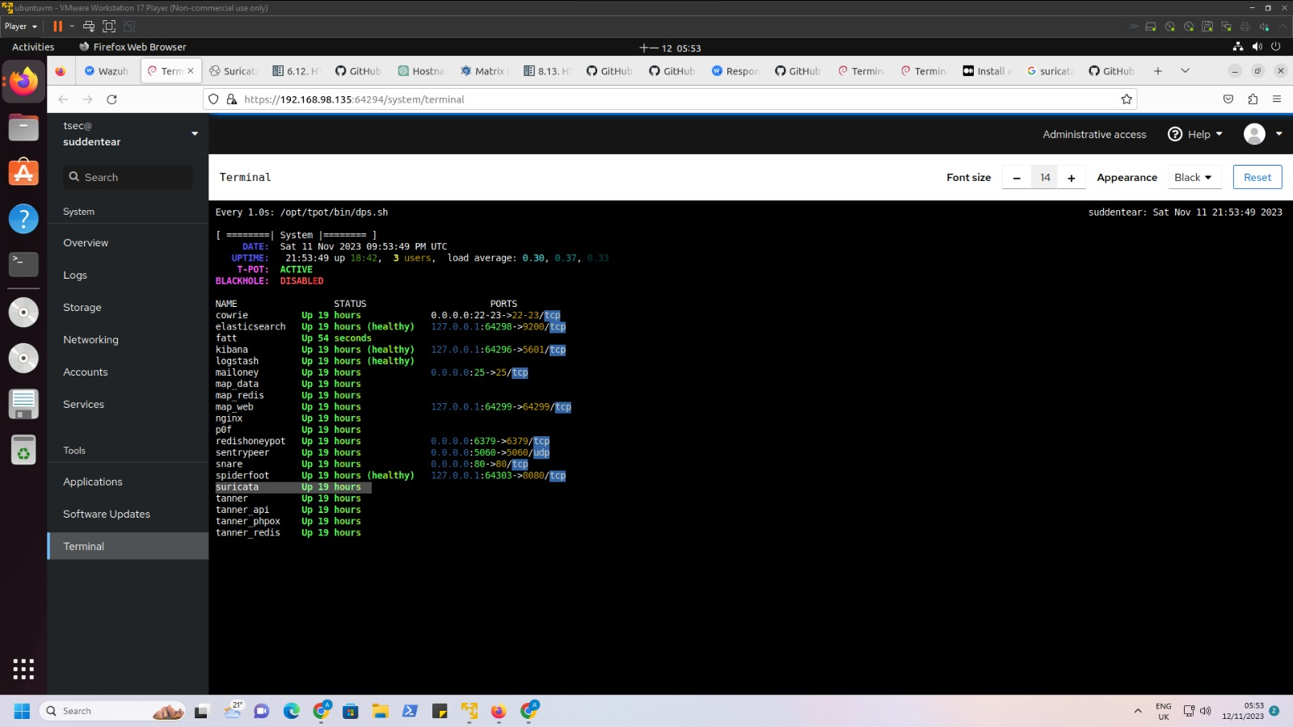

Slide 12
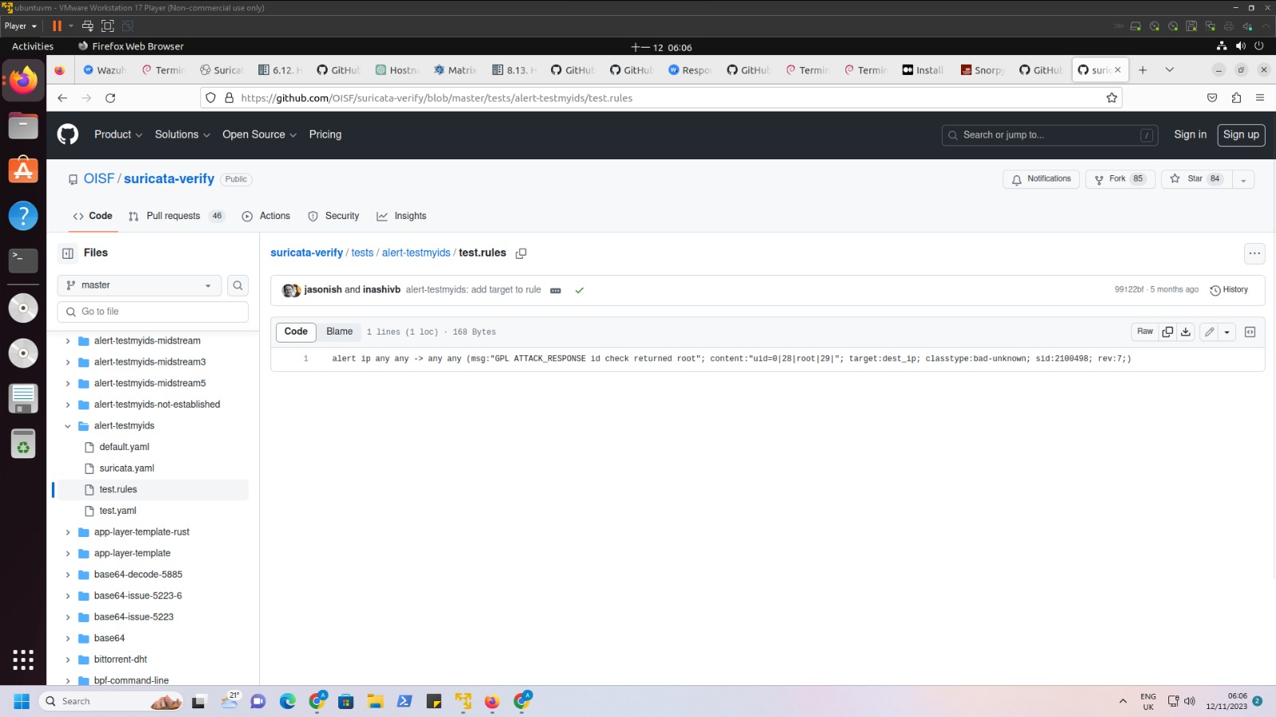
“GPL ATTACK_RESPONSE id check returned root”- This is the message associated with the alert. It indicates that the alert is related to an "id check returned root" in the ATTACK_RESPONSE category of the Emerging Threats GPLv2 ruleset.
It suggests that an identity (ID) check has returned a result indicating "root." In the context of network security, this could imply an attempt or activity that is associated with a user or system having elevated privileges or administrative access (root access).

Slide 13
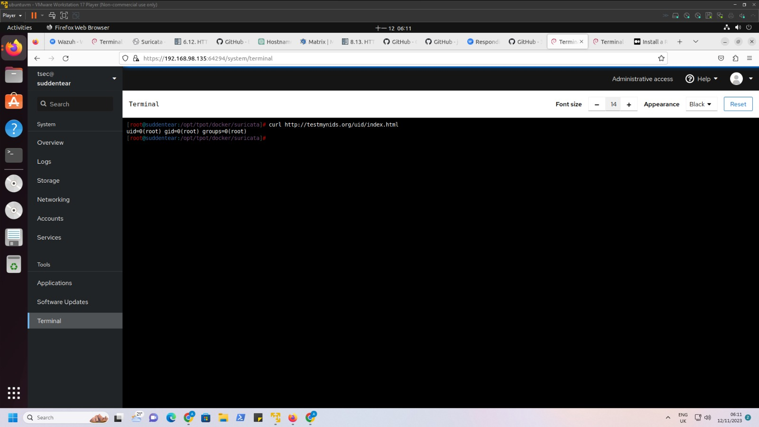
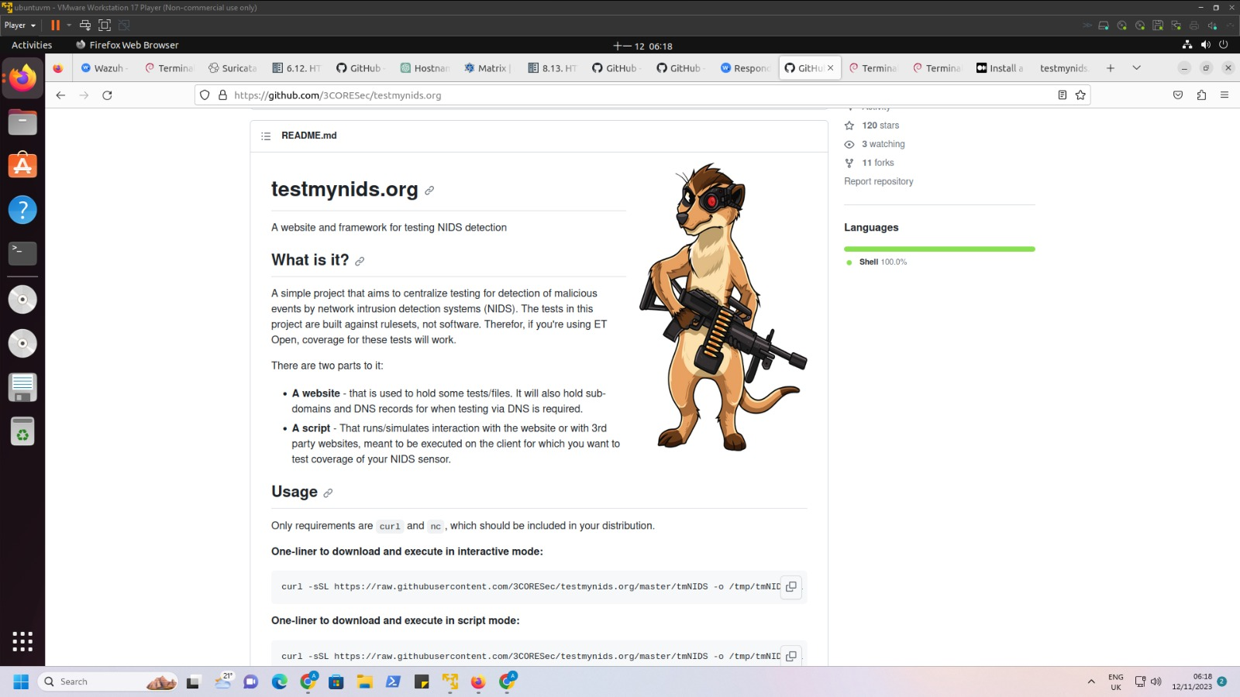
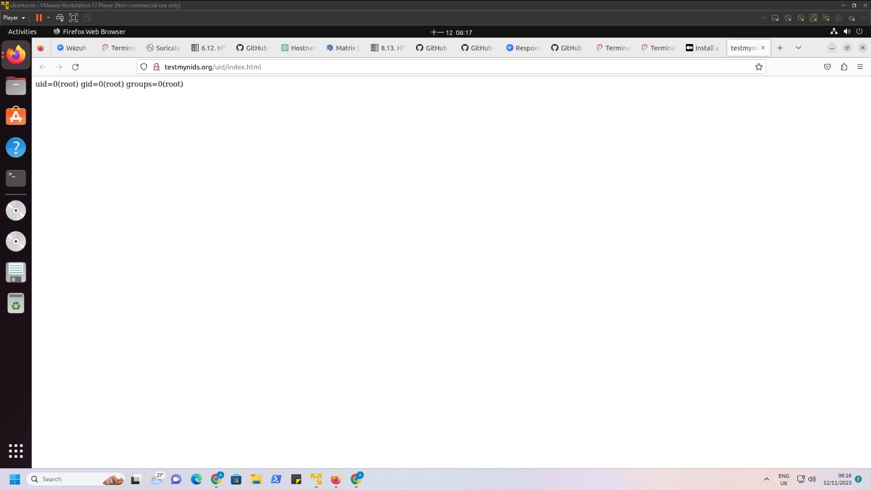
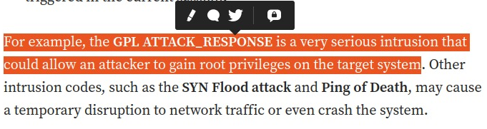

Slide 14
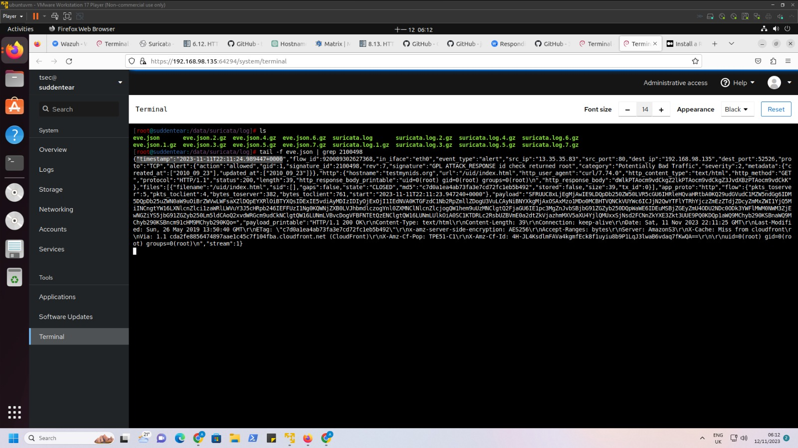

Slide 15
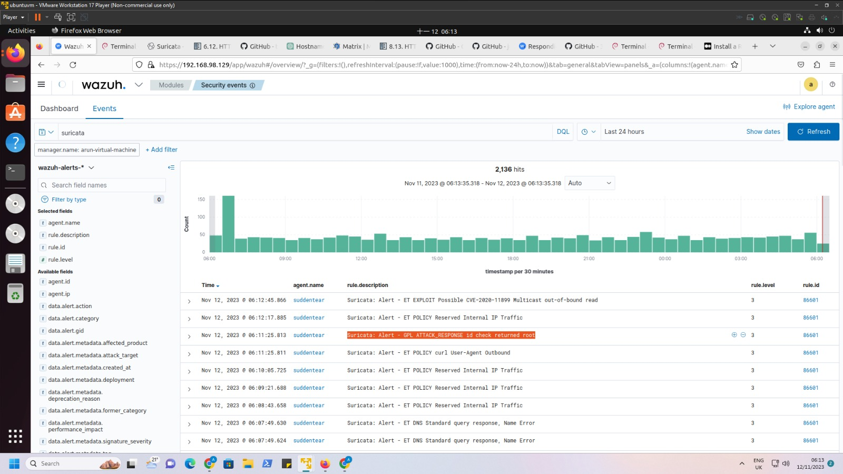
Integrated Suricata with Wazuh

Slide 16
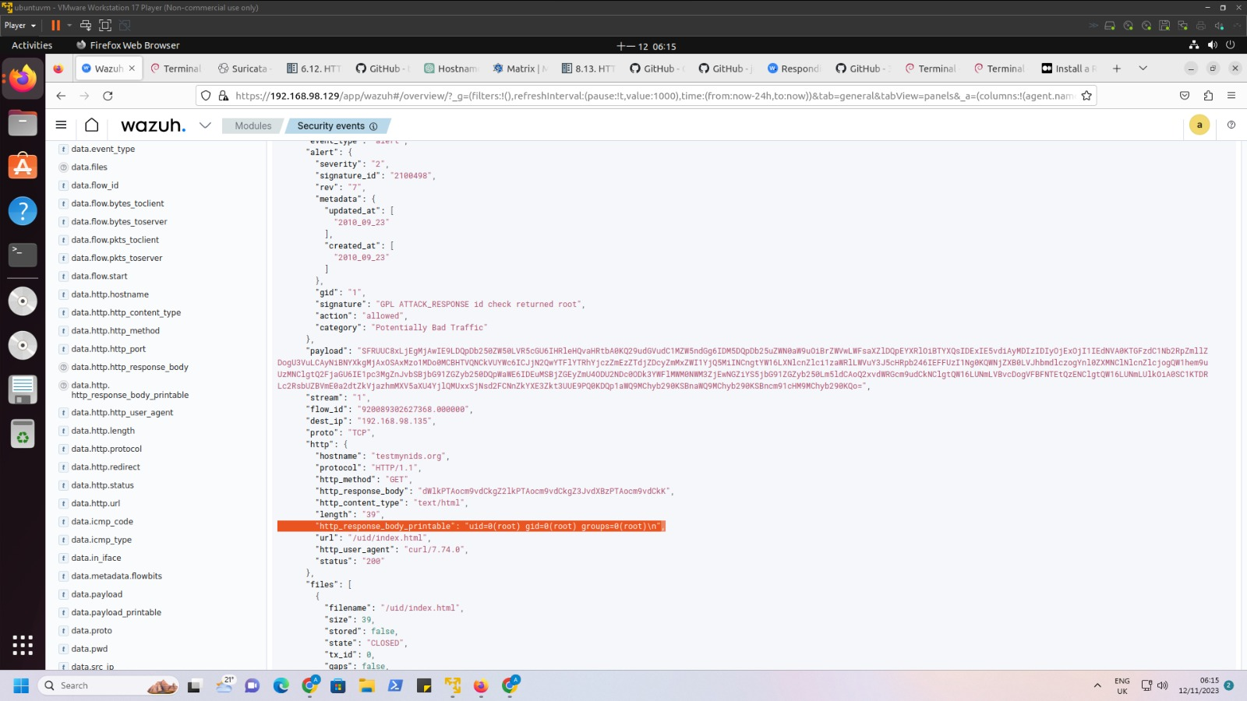
We can click on the alert generated and analyse the packets in a detailed way using Wazuh.

Slide 17
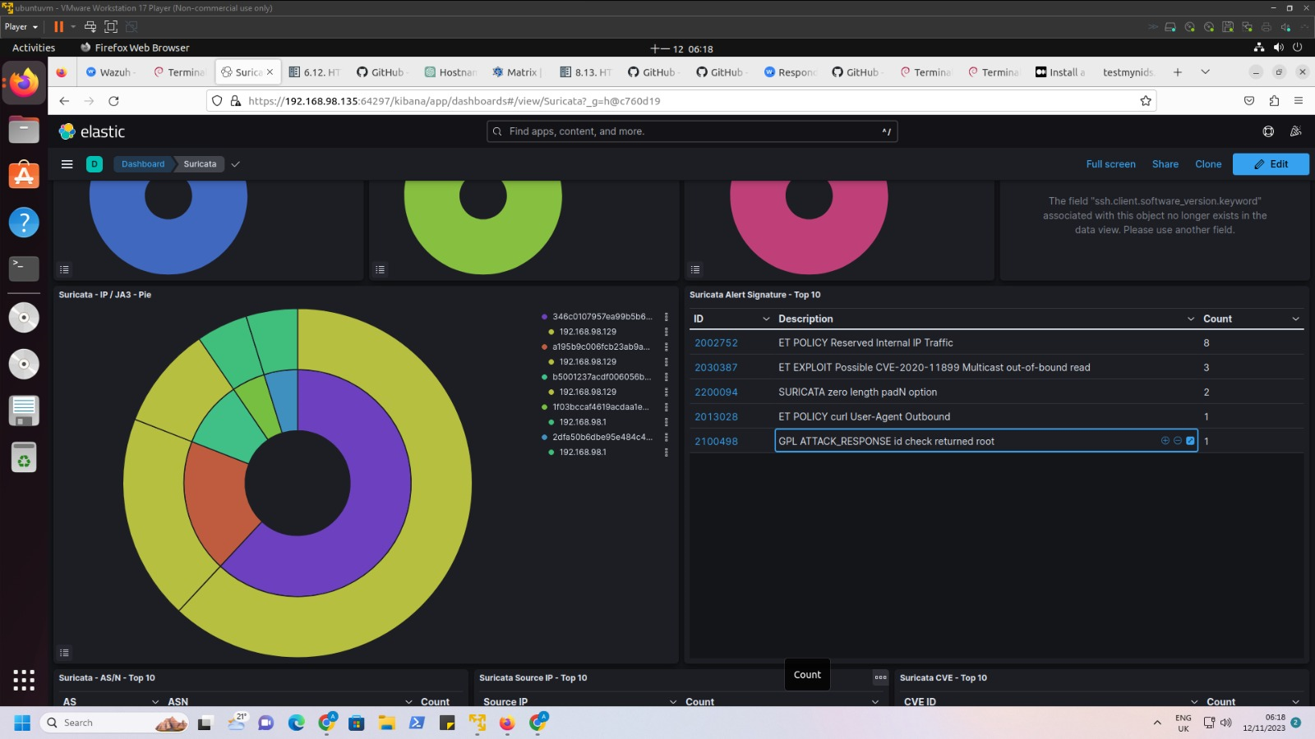
T-pot Elastic Search Dashboard

Slide 18
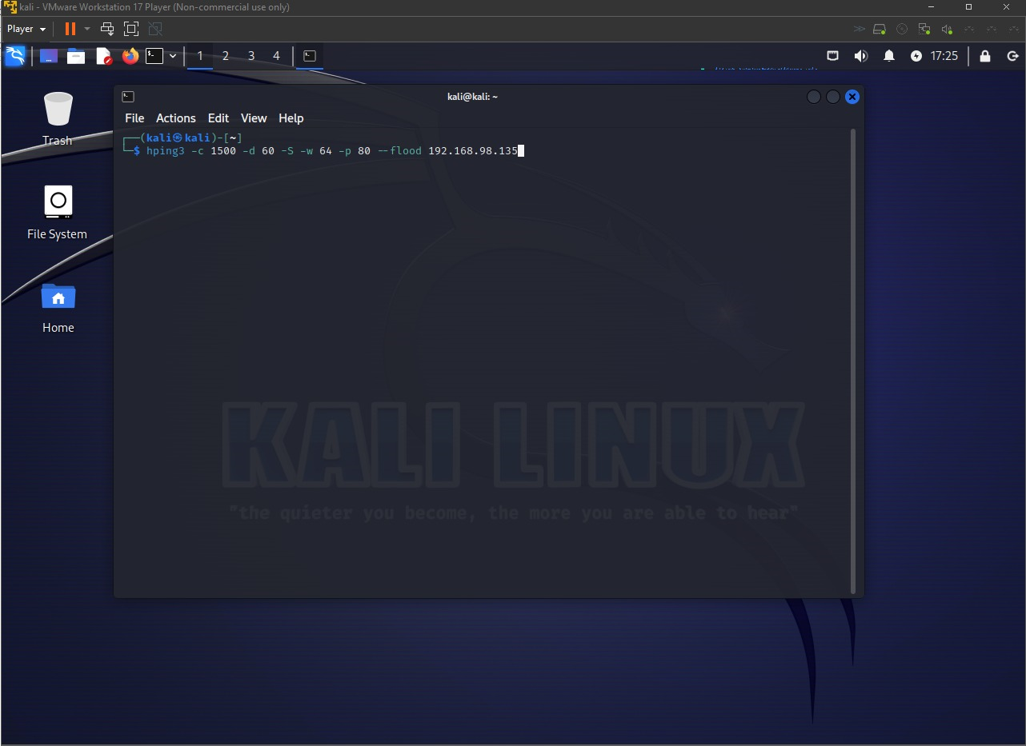
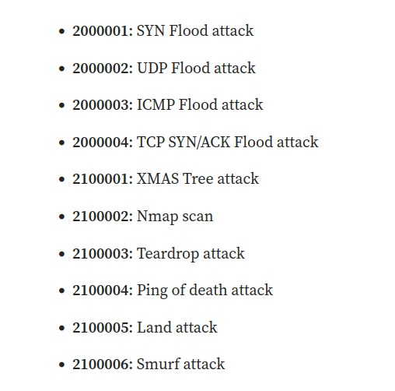
Some of the Attacks that can be detected by Suricata

Slide 19
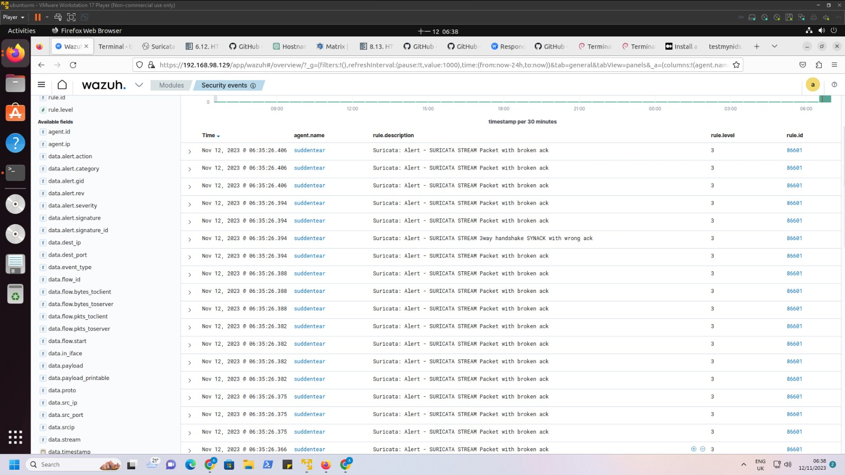

Slide 20
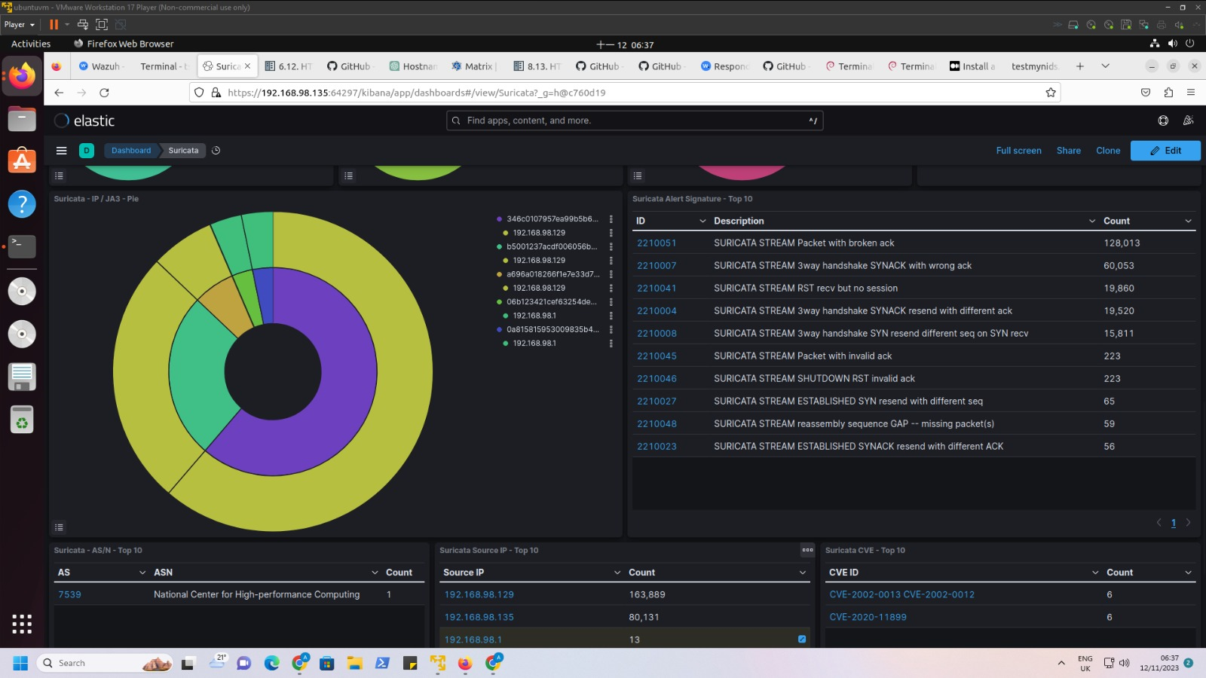

Slide 21
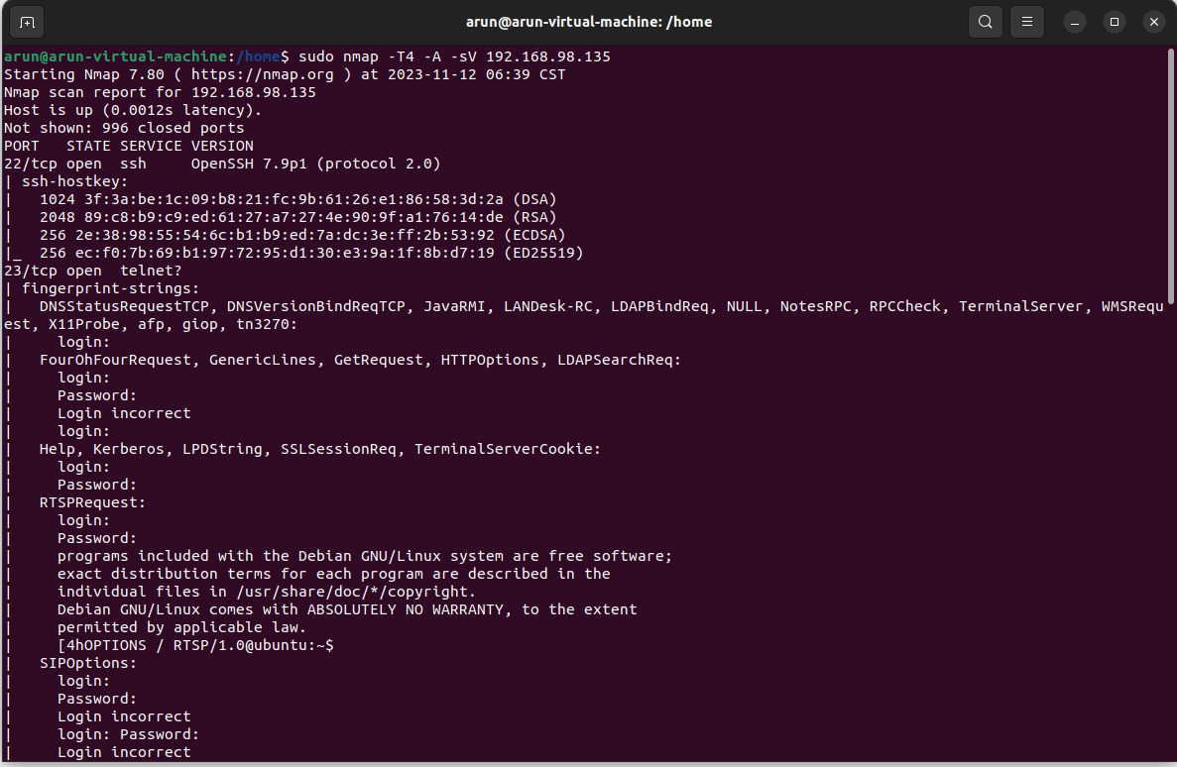
Nmap Scan

Slide 22
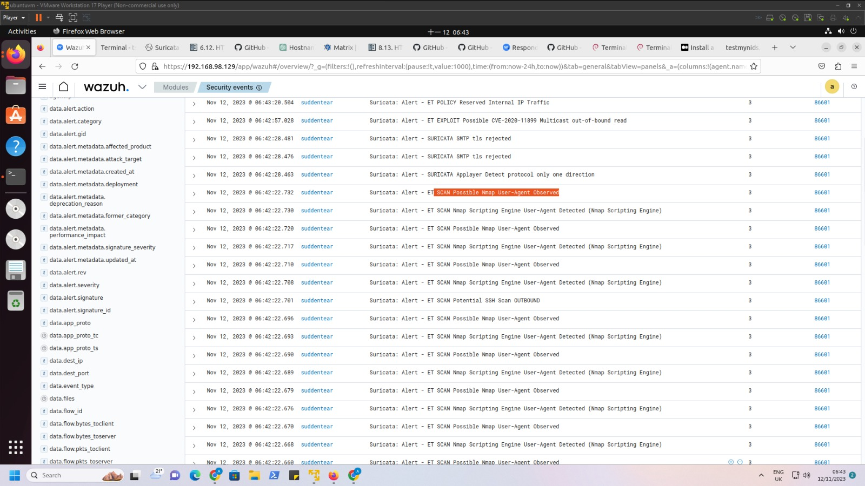

Slide 23
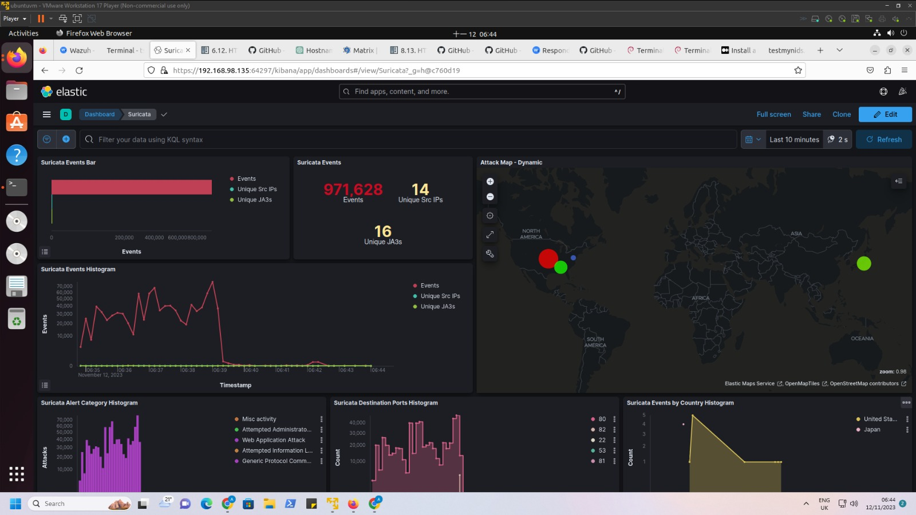

Slide 24
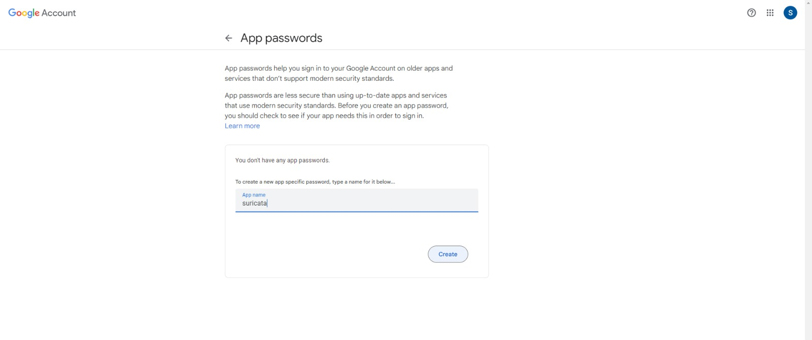
AUTOMATION OF EMAIL ALERTS FOR SURICATA
Step-1 : Using app passwords for email alert generation
Step-2 : Write a Python code for automation of email alerts

Slide 25
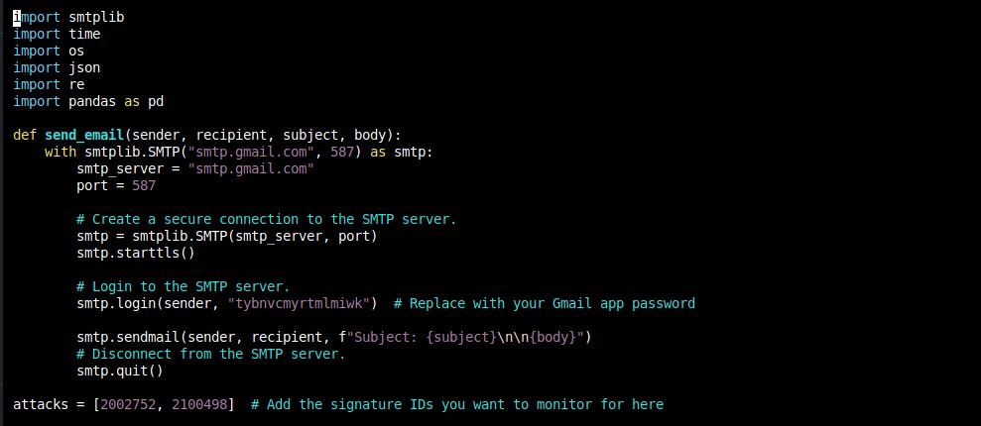
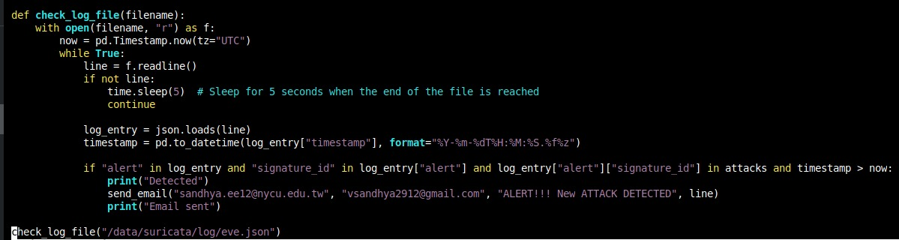
PYTHON CODE TO GENERATE AUTOMATION

Slide 26
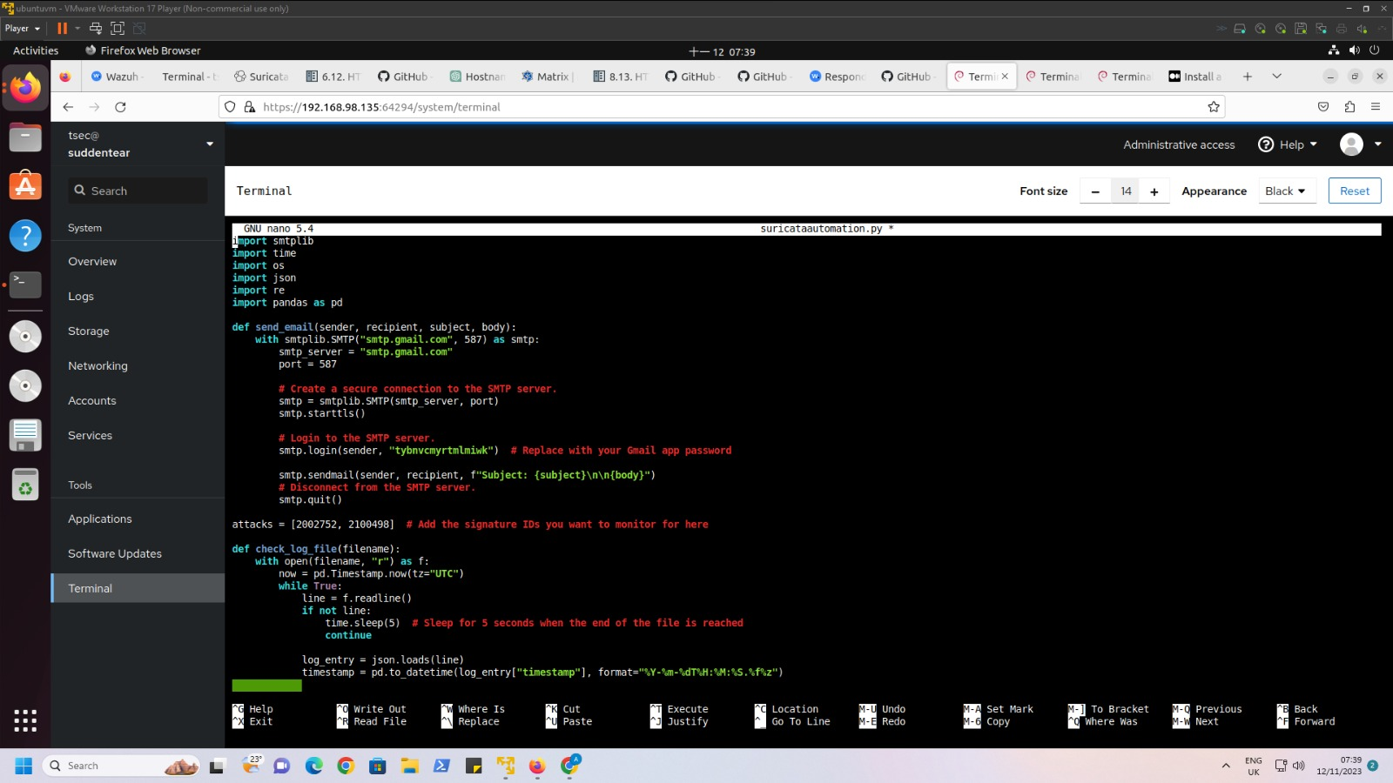

Slide 27
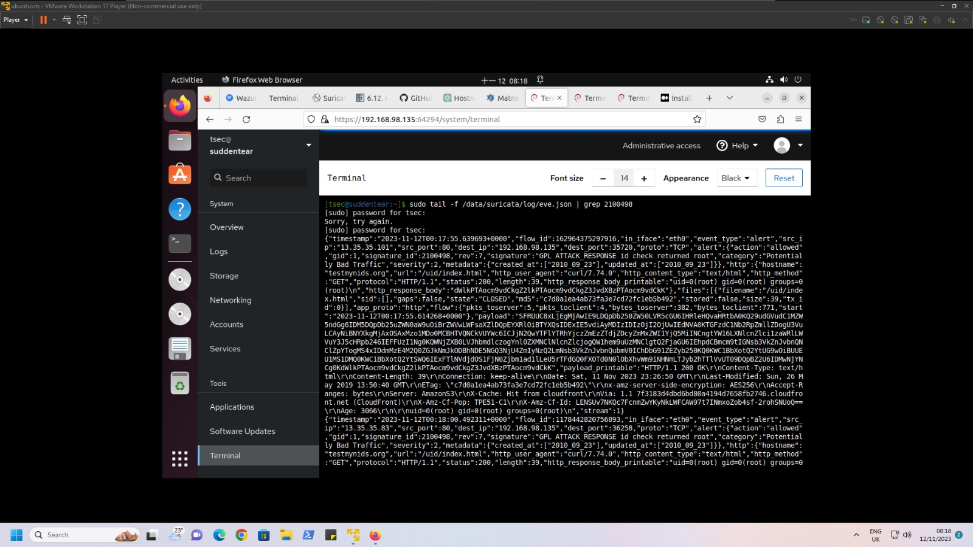

Slide 28
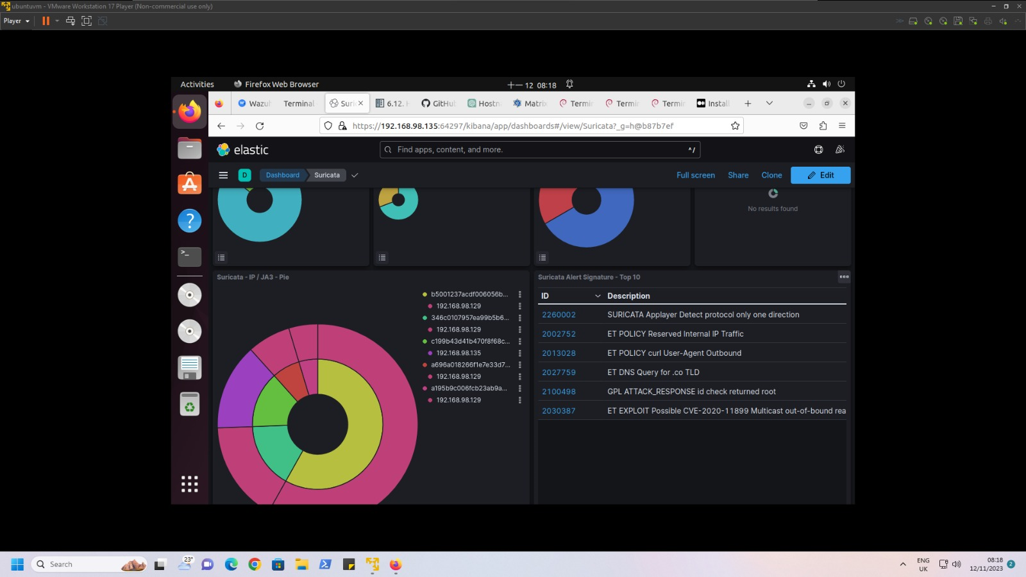

Slide 29
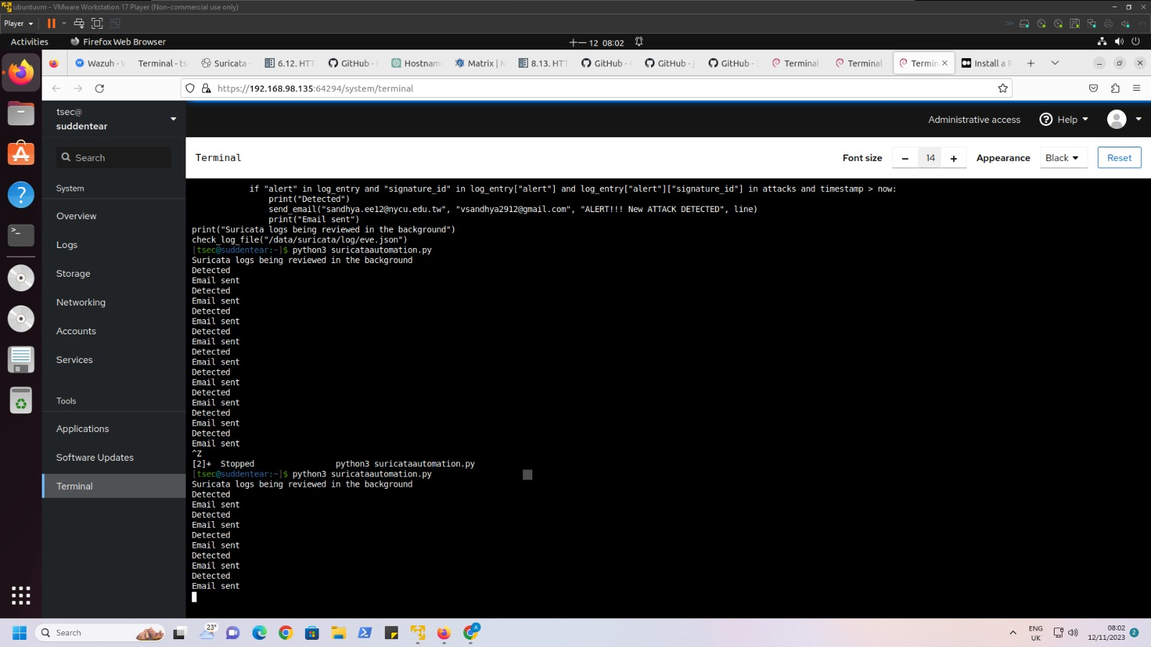

Slide 30


Slide 31
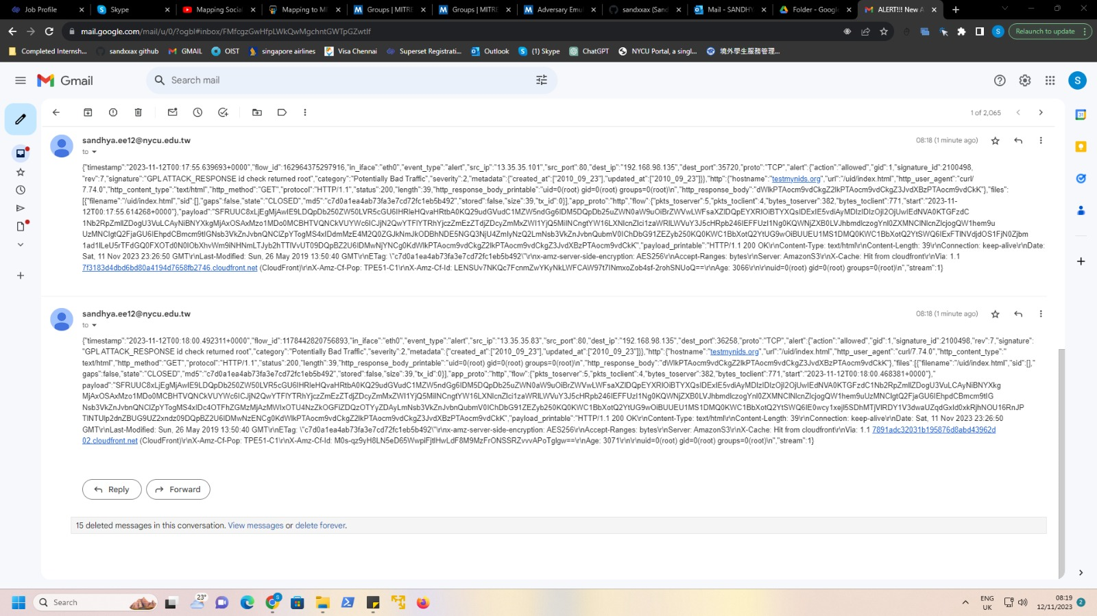

Slide 32
Things to do in the upcoming week
Deploy Wazuh for Malware detonation.
Contribute to the research paper.
Try to perform few attacks to check if my t-pot works efficiently.

Slide 33


